Slide 1
Student Internship Web Portal
BHANU & PARTH

Slide 2

Project Idea
Is to provide internships for students as per their area of interest

Slide 3

Research question
Can we expand the doors of opportunities for the students who are looking for industry work experience by providing internships in organizations with low cost ?

Slide 4

Aim & Objectives
The aim is to develop a web portal for student internships.
1. Designing a user-friendly interface.
2. Automating business processes to become more effective.
3. Improve user satisfaction through better service.

Slide 5
Measurable Organisational Values
Customer
Succeeded by assuring the perspective of
Financial
Improve revenue with the higher number of successful enrollments of students by providing them with a broad range of internship opportunities
Operational
Avoid incompetence in progress
students and students-to-be
provide with the essential
information and assistance required in a
appropriate manner
induced by missing documentation and
the lack of control in
documentation deliverables.

Slide 6

Added value
Cost
Solving Disputes

Slide 7

Methodology
Agile
Allows Design Change.
Adaptive Planning, Early Delivery And Continuous Improvement.

Slide 8


Technology
Database - MySQL
Frontend – Bootstrap
Backend – PHP

Slide 9

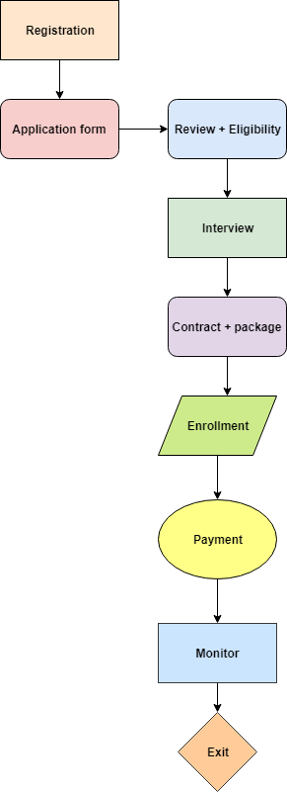
Student Enrolment Business Process

Slide 10
Who will get benefited?
Students
Internship company
Organisations

Slide 11
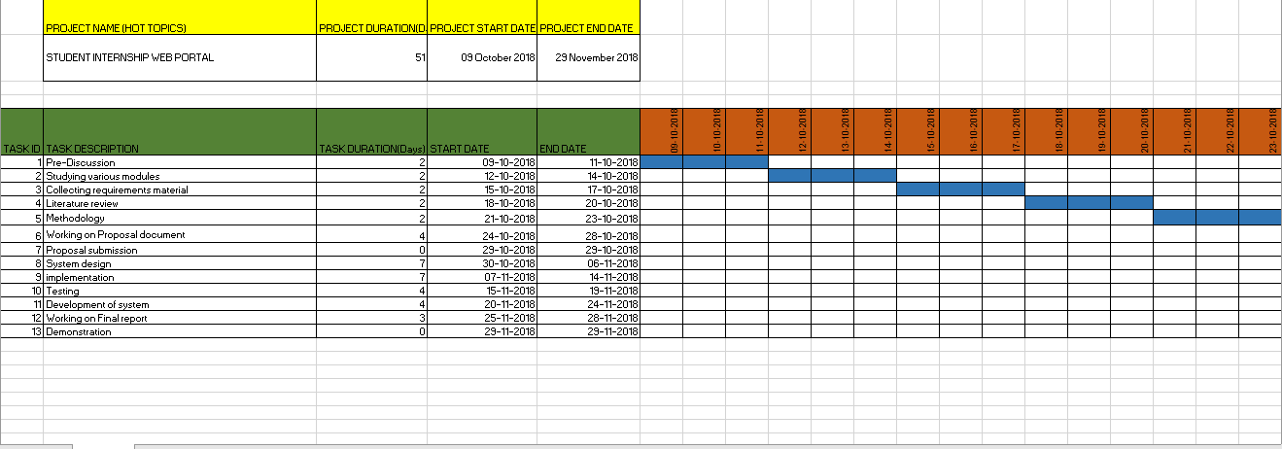
Gantt Chart

Slide 12



